Slide 1
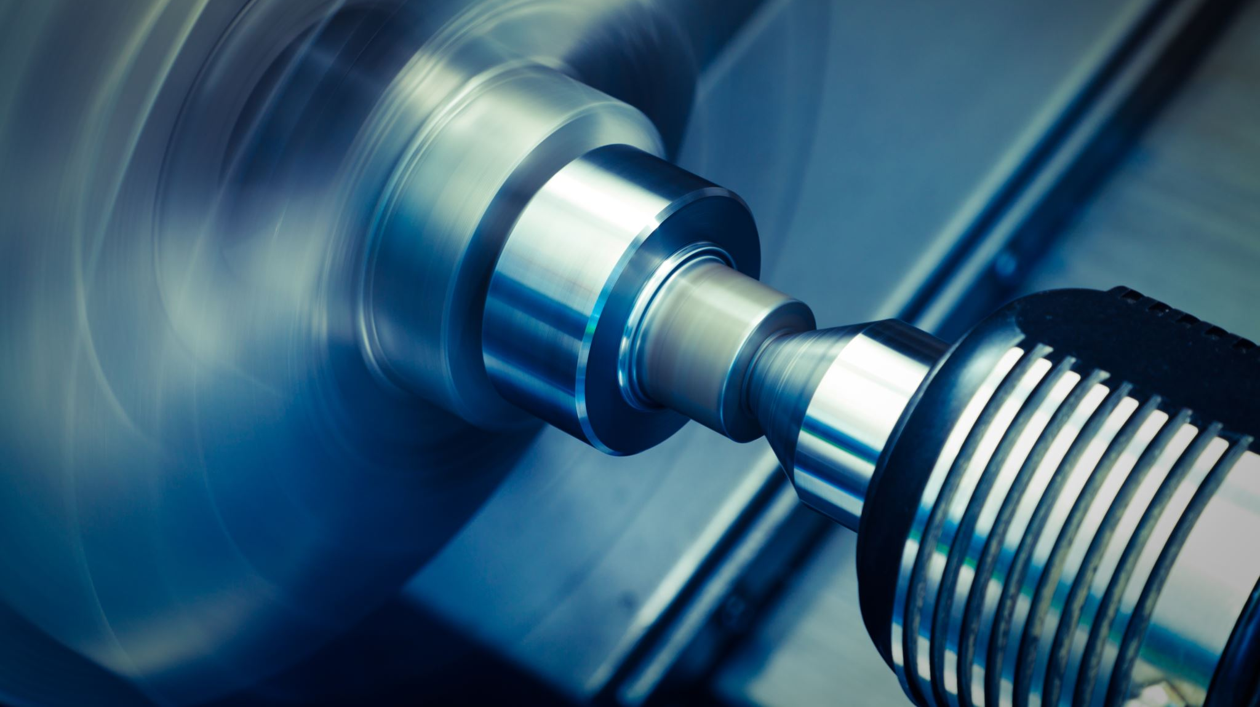
Digital Twin of a Rotating Shaft for Predictive Maintenance using MATLAB Simulink and Simscape
MDM2104 – Case Study: Intelligent Systems in Production
Group 9
Sameer K. Subair
Karthik Gopi
Nihal Sait Nishan
Abdul Rashid Kundladi

Slide 2
Previous Achievements
Simulink Digital Twin model created
Healthy & faulty shaft simulation done
Torque, angular velocity, & vibration signals extracted
FFT & RMS analysis implemented
Baseline fault signatures identified

Slide 3
Methodology Overview
1. System Identification:
ML Model 1 learns base shaft parameters from dataset.
2. Simulation:
Simulink generates vibration signals under healthy & faulty conditions.
3. Feature Extraction:
Extract RMS, FFT peaks, crest factor, harmonics, etc.
4. Machine Learning (Phase 1):
Decision Tree used for baseline parameter estimation.
5. Future Work:
Degradation Model + LSTM RUL model + Dashboard.
6. Feedback Loop:
Simulation → Features → Wear update → RUL → Next cycle.

Slide 4
Complete Digital Twin Workflow
The Digital Twin operates in a continuous loop that emulates real machine operation:
Initialization (Healthy State Setup)
ML Model 1 analyzes historical vibration datasets
Learns optimal base parameters:
Spring = 500 N·m/rad
Damper = 0.50 N·m·s/rad
Inertia = 0.124 kg·m²
Environmental factors initialized (temperature, humidity, dust, environment type)
Historical database initialized
Simulation Cycle (1 cycle = 1 simulated hour)
Run Simulink shaft model using current parameters
Generate vibration signals (torque, velocity, displacement)
Extract 12+ features (RMS, peak, crest factor, FFT peaks, band energies)
Wear Update (Future Phase)
ML Model 2 calculates parameter degradation based on:
Operating conditions
Environmental conditions
Historical vibration trends
Produces updated parameters (e.g., spring stiffness ↓, damping ↑)
RUL Prediction (Future Phase)
ML Model 3 (BiLSTM) reads last 30-day vibration history
Predicts Remaining Useful Life
Stores prediction + updated parameters
Dashboard Update
System visualizes health state, vibration evolution, and predicted RUL
This loop repeats continuously, creating a true real-time digital twin.

Slide 5
Planned Architecture – Degradation Model
Inputs :
Vibration features from last hour
Environmental conditions
Current shaft parameters
Operation duration
Core Logic :
Regression-based degradation estimation
Example :
Spring decreases 0.05–0.2% per hour
Damper increases based on contamination
Inertia changes due to micro-deformation
Outputs :
Updated spring stiffness
Updated damping coefficient
Updated inertia
Wear state saved

Slide 6
Planned Architecture – LSTM RUL Model
Input:
30-day vibration feature history
Sequential time-series data
Neural Network:
BiLSTM (128 units)
Dropout (0.3)
Dense layer
Regression output
Output:
Predicted RUL
Prediction confidence
Progressive degradation trend

Slide 7
Kaggle Dataset
Dataset: Vibration Analysis on Rotating Shaft (Kaggle)
https://www.kaggle.com/datasets/jishnukoliyadan/vibration-analysis-on-rotating-shaft
Contains vibration data under:
Healthy shaft
Misalignment
Unbalance
Bent shaft
Bearing faults
Data Type:
Accelerometer vibration signals (time-series)

Slide 8
Data Preprocessing
Performed the following:
Imported vibration CSV files
Filtered high-frequency noise
Segmented data into windows
Normalized each window
Labeled signals (healthy vs fault type)

Slide 9
Feature Extraction
Extracted the following from each window:
Time-Domain Features
RMS
Peak-to-peak
Crest factor
Kurtosis
Frequency-Domain Features
FFT dominant peak
Harmonics
Spectral band energy
These features are used for ML training

Slide 10
Machine Learning Model
Implemented Decision Tree Classifier as first ML model.
Steps Completed:
Combined features from Simulink + Kaggle
Split into train/test sets
Trained baseline Decision Tree
Performed classification of faults
Output:
Model successfully identifies basic fault patterns
Serves as baseline for future deep learning models

Slide 11
Results of ML Model
Decision Tree trained on extracted features
Successfully classified healthy vs faulty samples
Provided first baseline accuracy
Identified need for more advanced sequence models (later phase)

Slide 12
Summary of Work Completed
Dataset integrated
Preprocessing completed
Feature extraction completed
Healthy–faulty comparison validated
Baseline ML model implemented
Feature matrix generated for next phase

Slide 13
Future Goals
Implement Degradation Model (ML Model 2)
Develop LSTM-Based RUL Prediction Model (ML Model 3)
Integrate Digital Twin with ML Models
Build Interactive Dashboard
Full End-to-End Predictive Maintenance Digital Twin

